Slide 1
A Study Of The Book Of Revelation
September 6, 2020

Slide 2
Resources used:
A Study Of The Book Of Revelation by Bob Dodson
More Than Conquerors by William Hendriksen
Overcoming With The Lamb, Florida College Annual Lectures, February 7-10, 1994
Revelation: An Introduction and Commentary by Homer Hailey
Revelation (Truth Commentaries) by Robert Harkrider
Revelation (A Study Workbook) by Robert Harkrider
Revelation by Donnie Rader
Studies In The Book Of Revelation by Ferrell Jenkins
The Old Testament In The Book Of Revelation by Ferrell Jenkins
The Revelation Of Saint John The Divine by G.B. Caird
The Book of Revelation by Foy E. Wallace
The Avenging of the Apostles and Prophets by Arthur M. Ogden
Worthy Is The Lamb by Ray Summers
Written exchange on “The Domitian Persecution” between Arthur M. Ogden and Ferrell Jenkins presented in Searching The Scriptures, June 12, 1989, pages 7-12

Slide 3
Revelation
I. Struggle on Earth (1-11)
A. John’s Vision (1)
B. Letters to 7 churches (2-3)
C. God in control (4-5)
D. Opening of seven seals (6-11)

Slide 4
Revelation
II. Christ And The Dragon In Conflict (12-22)
(Deeper Spiritual Meaning)
A. War (12-14)
B. Bowls of Wrath (15-16)
C. Fall of Babylon the Harlot (17-18)
D. Victory of God’s people (19-21)
E. Warnings about the Book (22)

Slide 5
Revelation 4 and 5
“God Is On His Throne” – In Control
Chapter 4
Outline
I. God On His Throne (verses 1-3)
II. What Was Around The Throne (verses 4-8a)
III. Worship Before The Throne (verses 8b-11)

Slide 6
Revelation 4 and 5
What Is The Point?
God is still on His throne!
He is still in control!
It’s not over yet!

Slide 7
Revelation 4 and 5
What Is The Point?
“He is invited by the first voice (1:10, the voice of Christ) to come to a place of advantage from which he will be able to see things from God’s viewpoint. From John’s point of view from Patmos there is a dark picture meeting the eye. But when he is able to see things from God’s point of view, the coloring is changed radically. From that point of view he can see the eternal throne of God, which does not shake before the threats of Domitian and men of such character …

Slide 8
Revelation 4 and 5
What Is The Point?
… From the heavenly angle there is no doubt about the outcome of the struggle in which the Christians are engaged. Immediately the spiritual experience was intensified, and John saw the first guarantee of victory – God is on his throne. The Christians needed assurance; here it is: God has not abdicated in favor of Domitian or any other. In the very center of the vision is the sovereign God on his throne.”
– Ray Summers, Worthy is the Lamb, Page 130

Slide 9
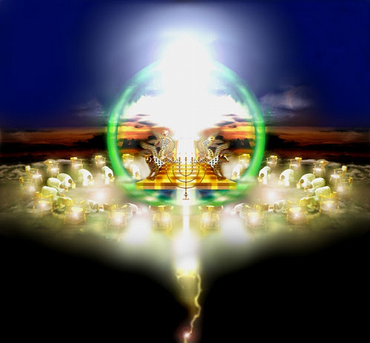
Revelation Chapter 4 God Is On His Throne
Revelation 4 and 5
The Reigning God

Slide 10

Revelation 4:1
Revelation 4 and 5
“After these things I saw, and behold, a door opened in heaven, and the first voice that I heard, (a voice) as of a trumpet speaking with me, one saying, Come up hither, and I will show thee the things which must come to pass hereafter.”
A Door Opens in Heaven!

Slide 11
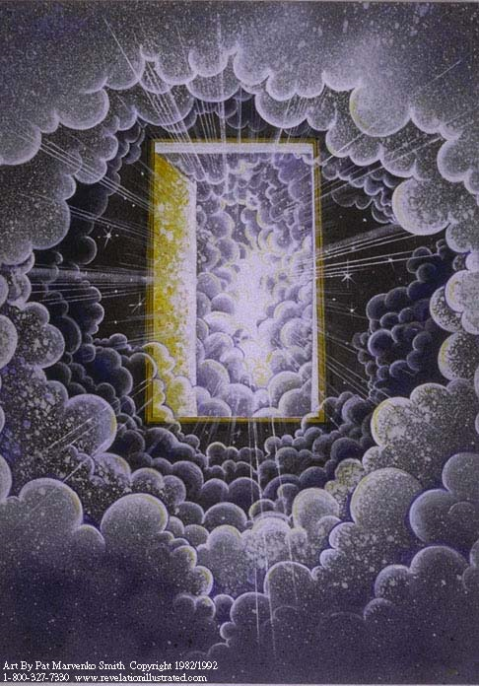
Revelation 4 and 5
Open Door in Heaven

Slide 12
The Open Door
Revelation 4 and 5
John’s invitation
He saw an “open door” in heaven.
He heard a voice speaking.
It sounded “like” a trumpet.
Commanded to come “up here”
Will be shown things that “must come to pass hereafter”
A preview of coming events

Slide 13
Revelation 4:2
Revelation 4 and 5
“Straightway I was in the Spirit: and behold, there was a throne set in heaven, and one sitting upon the throne”
“In the Spirit”

Slide 14
Throne Scene
Revelation 4 and 5
John’s invitation
He was “in the spirit” (1:10; 2 Corinthians 12:2-4)
Saw a throne set in heaven.
It is the seat of sovereignty, the symbol of regal authority, from which justice and judgment are dispensed. (Psalms 89:14)
The throne was not there for this vision only, it was set, established as the throne of heaven. (Psalms 119:89)
Saw one “sitting” on that throne

Slide 15
Revelation 4:3
Revelation 4 and 5
“and he that sat (was) to look upon like a jasper stone and a sardius: and (there was) a rainbow round about the throne, like an emerald to look upon.”
His Appearance

Slide 16
Ezekiel 1:26
Revelation 4 and 5
“And above the firmament that was over their heads was the likeness of a throne, as the appearance of a sapphire stone; and upon the likeness of the throne was a likeness as the appearance of a man upon it above.”
Ezekiel’s Vision

Slide 17
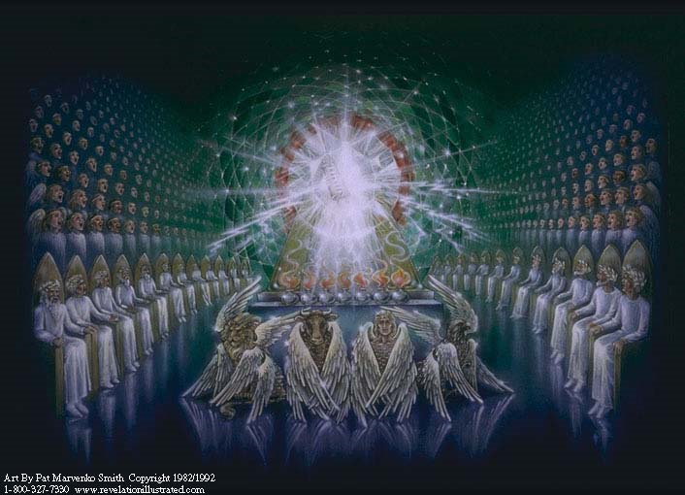
Revelation 4 and 5

Slide 18
Throne Scene
Revelation 4 and 5
John’s vision
Throne “standing in heaven” above all others
Cannot be overthrown
Occupant …
Seen in splendor – precious stones
Seen in His “covenant relationship” to man
“Rainbow” around the throne
“Sitting” on the throne

Slide 19

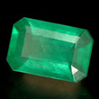
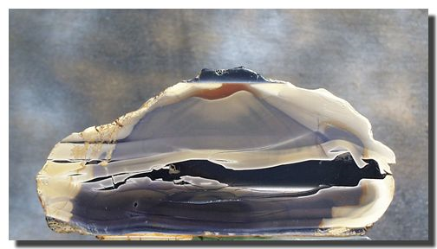
Revelation 4 and 5
Jasper was an opaque species of different colors, subject to high polish. The New Testament use of the term “jasper,” here and elsewhere referred to a transparent gem, the diamond, or the translucent chalcedon.
Sardius was an ancient favorite of the engraver’s art, discovered in Asia Minor, of lasting beauty of color; it was a brilliant flesh red.

Slide 20
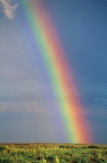
Revelation 4 and 5
“A rainbow round about the throne” – 4:3.
The rainbow stands for a covenant (Genesis 9:13-17)
and the emblem here is of the covenanted protection from the judgment of impending events ; not escape from the suffering, but exemption from judgments, which would come upon the enemies of the church.

Slide 21
Revelation 4 and 5
“In sight like an emerald” – 4:3.
The rainbow is a seven-color reflection. Its brilliance
appears between the shining sun and the rain clouds. Here emerald in the bow is specified – a very precious gem, of deep green color – which is its real value, as the deepest colors were the prized. The word emerald had a root meaning of glowing.

Slide 22
Revelation 4:4
Revelation 4 and 5
“ And round about the throne (were) four and twenty thrones: and upon the thrones (I saw) four and twenty elders sitting, arrayed in white garments; and on their heads crowns of gold.”
24 Elders

Slide 23
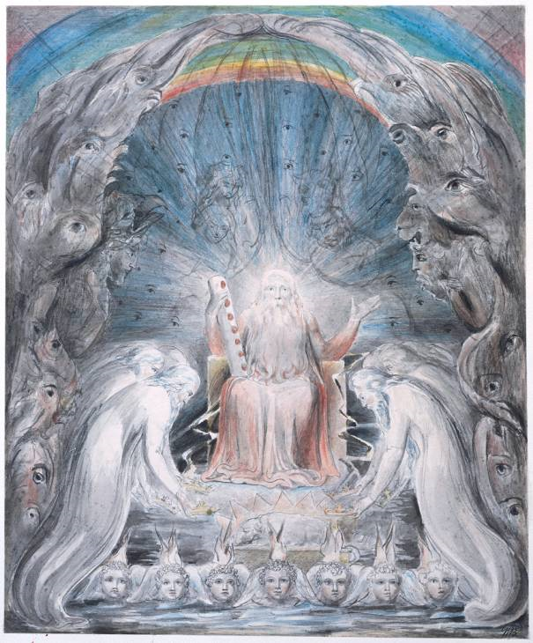
Revelation 4 and 5

Slide 24
24 Thrones – 24 Elders
Revelation 4 and 5
24 Thrones – 24 Elders = “organized religion” (12)
God’s “redeemed” on both sides of the cross? (21:12-14) Not until the final consummation …
Around the throne
Clothed in white garments
Golden crowns (stephanos = victory)

Slide 25
24 Thrones – 24 Elders
Revelation 4 and 5
24 Elders
Holy, victorious rule
God’s heavenly council
Offer continual worship – 4:10-11

Slide 26
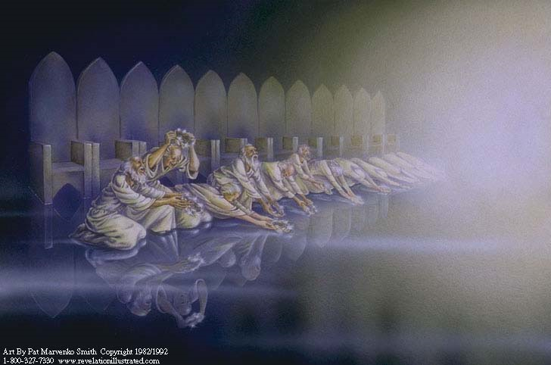
Revelation 4 and 5

Slide 27
Revelation 4:5
Revelation 4 and 5
“And out of the throne proceed lightnings and voices and thunders. And (there was) seven lamps of fire burning before the throne, which are the seven Spirits of God”
From the Throne

Slide 28
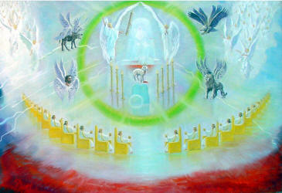
Revelation 4 and 5

Slide 29
Powerful Throne
Revelation 4 and 5
Powerful decrees from the throne
Lightnings, thunderings, and voices. cf. Exodus 19:16
“Seven lamps” of fire burning (light)
“Seven Spirits” of God = Holy Spirit (cf. 1:4)
Since the work of the Holy Spirit is that of illumination of the truth (John 16:13), lamps of fire burning offer a graphic portrayal of this mission.
The glory, majesty, splendor, and brilliance of God’s rule
To be sure – God is in control and on the throne!

Slide 30
Revelation 4:6
Revelation 4 and 5
“and before the throne, as it were a sea of glass like a crystal; and in the midst of the throne, and round about the throne, four living creatures full of eyes before and behind.”
Sea of Glass

Slide 31
Sea of Glass
Revelation 4 and 5
Would seem to separate the 24 elders from the throne of God
The “best glass” would be like crystal, with normal glass being dark, dull, or even opaque.
That which is precious also separates those who are able to approach the throne from God Himself.
Later John relates that there is “no more
sea” (21:1).
“Perhaps the difference is that what John sees now are events that occur before the final judgment, but after 20:11-15 he describes a heavenly scene wherein God will dwell with all saints (21:3).” (Harkrider)

Slide 32
Revelation 4:7
Revelation 4 and 5
“And the first creature (was) like a lion, and the second creature like a calf, and the third creature had a face as of a man, and the fourth creature (was) like a flying eagle.”
Four Living Creatures

Slide 33
Four Living Creatures
Revelation 4 and 5
“Full of eyes” – all-seeing ability
“Cherubim” (Ezekiel 10:5, 10, 18, 20) “Seraphim” (Isaiah 6:1-2)
“Lion” – strength
“Calf” – service
“Man” – intelligence
“Flying Eagle” – velocity and swiftness
These living creatures are special servants of God – strong, swift, intelligent, and always vigilant. Beings of the highest order that guard holy things of God and never fail to worship.

